Slide 1



MOVIE RECOMMENDATION APP
Built with HTML, CSS, and JavaScript
BY AKSHITH KUMAR GUNJUR

Slide 2

PROJECT OVERVIEW
PURPOSE: THIS PROJECT IS A MOVIE RECOMMENDATION WEB APPLICATION USING THE TMDB API.
Features:
Allows users to search for movies.
Displays movie details such as title, rating, and overview.
Responsive layout for various devices.

Slide 3

TECHNOLOGIES USED
HTML: THE STRUCTURE OF THE WEB PAGE.
CSS: FOR STYLING AND LAYOUT.
JAVASCRIPT: TO HANDLE THE LOGIC AND INTERACTION (FETCHING DATA FROM TMDB API).
API: TMDB API TO FETCH MOVIE DATA.

Slide 4
HTML STRUCTURE
The HTML file (index.html) contains the basic structure of the website.
The <header> contains a title and search input field for movie search.
The <main> is where the movie cards are dynamically displayed.
The <footer> provides a note about the TMDb API.

Slide 5
CSS STYLING
The style.css file provides the styling for the website.
It uses custom colors for theming (primary-color, secondary-color).
Flexbox is used to layout the content and ensure responsiveness.
Hover effects on movie cards to reveal more details.

Slide 6
JAVASCRIPT FUNCTIONALITY
The script.js file handles the logic for fetching movie data from the TMDb API and rendering it on the page.
The getMovies function fetches movie data from the API.
The showMovies function dynamically generates HTML content for each movie and appends it to the <main> section.
The getClassByRate function assigns color codes based on the movie rating.

Slide 7
MOVIE CARDS AND INTERACTION
The application dynamically displays movie cards.
Each card contains:
Movie poster image.
Movie title and rating.
Hover effect reveals the movie's overview.

Slide 8
DEPLOYMENT ON GITHUB PAGES
The website is hosted using GitHub Pages.
After pushing the files to GitHub, GitHub Pages was enabled in the repository settings, allowing the site to be accessed via a custom URL like: https://github.com/akshith5475/movie-app.git

Slide 9
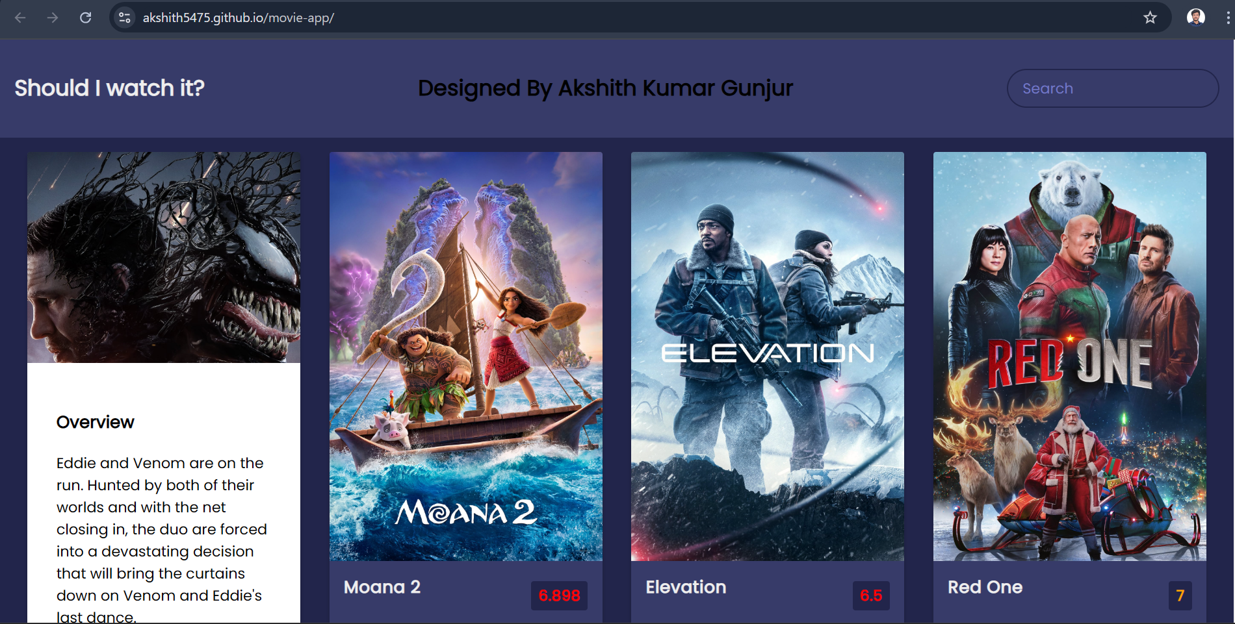

Slide 10

THANK YOU

